Slide 1
Set Theory: Cardinality

Slide 2
康托尔的无限王国

Slide 3
Cardinality of finite sets: number of elements in the set. (also called size)
The cardinality of a set A is often denoted as |A|, #A, card(A).
Example: set A = {1, 2, 3}.
A contains three elements, therefore A has a cardinality of 3.
How about the cardinality of infinite sets?

Slide 4
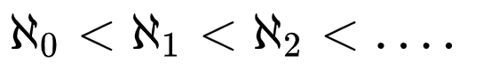
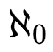
.
.
Cardinality of infinite sets:
The cardinality of natural numbers is denoted as…….
Question:
the cardinality of positive even numbers ?
the cardinality of all integers?
the cardinality of rational numbers?
the cardinality of real numbers?

Slide 5
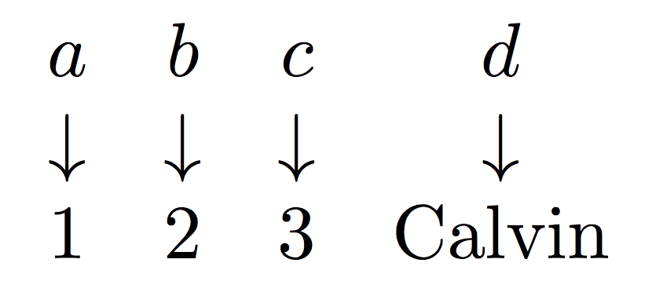
|A| = |B|, if and only if there exists a bijection from A to B.
(This is true for both finite sets and infinite sets.)
Example:
A = {a, b, c, d}
B = {1, 2, 3, Calvin}

Slide 6
Any set X that has the same cardinality as the set of the natural numbers,
or |X| = |N| = , is said to be a countably infinite set.
Basically, an infinite set is countable if its elements can be listed in an inclusive and organized way. “Listable” might be a better word, but it is not really used.
Any set X with cardinality greater than that of the natural numbers, or |X|>|N|, is said to be uncountable.

Slide 7
1. #positive even numbers = . Function f(n) = 2n. (a one-to-one correspondence)
can be written as 2, 4, 6, 8,…
2. #integers =
Can be written as 0, 1, -1, 2, -2,…
Hilbert’s Paradox of the Grand Hotel

Slide 8
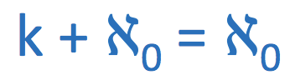
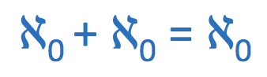
Hilbert’s Grand Hotel
Consider a hotel with infinitely many rooms, all of which are occupied (filled at capacity).
k new arrivals to the filled hotel.
Everybody moves up K rooms, so if they are in room n they move to room n + k.
Correspondence n → n + k
Infinite number of new arrivals.
Everybody moves to the room with number twice that of their current room: n → 2n

Slide 9
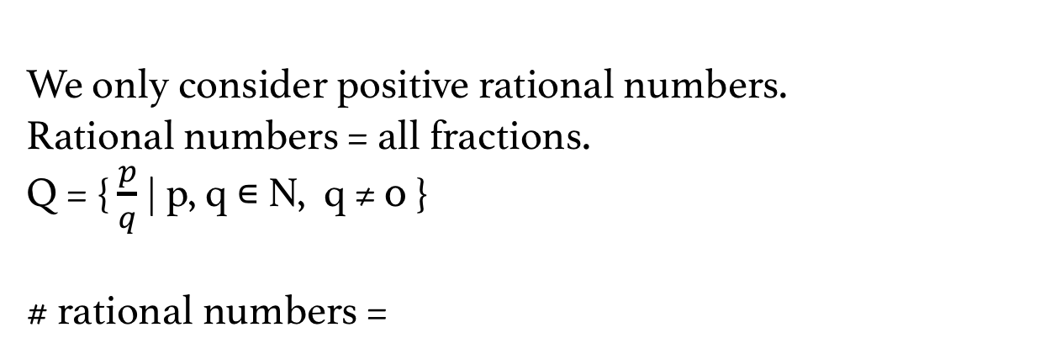
Cardinality of rational numbers
We only consider positive rational numbers.
Rational numbers = all fractions.
Q = { $\frac{p}{q}$ | p, q ∊ N, q ≠ 0 }
# rational numbers =

Slide 10
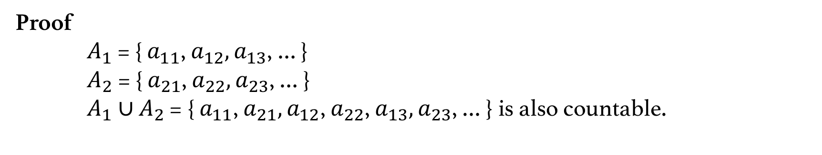
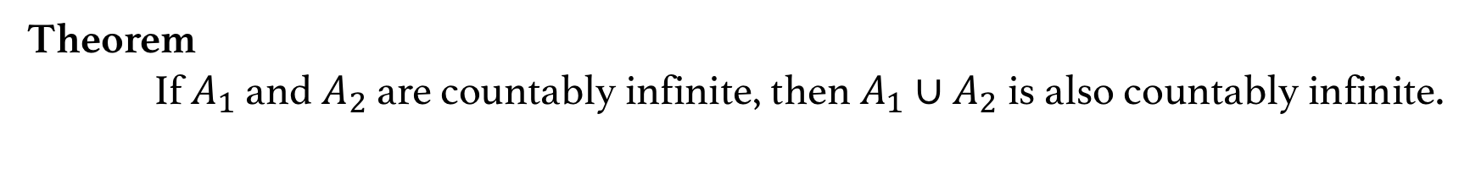
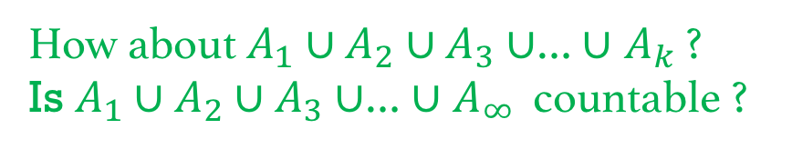
Theorem
If $A_{1}$ and $A_{2}$ are countably infinite, then $A_{1}$ ∪ $A_{2}$ is also countably infinite.
Proof
$A_{1}$ = { $a_{11}$, $a_{12},a_{13}$, … }
$A_{2}$ = { $a_{21}$, $a_{22},a_{23}$, … }
$A_{1}$ ∪ $A_{2}$ = { $a_{11}$, $a_{21},a_{12}$, $a_{22}$, $a_{13},a_{23}$, … } is also countable.
How about $A_{1}$ ∪ $A_{2}$ ∪ $A_{3}$ ∪… ∪ $A_{k}$ ?
Is $A_{1}$ ∪ $A_{2}$ ∪ $A_{3}$ ∪… ∪ $A_{∞}$ countable ?

Slide 12
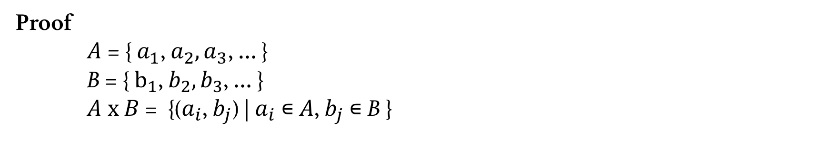
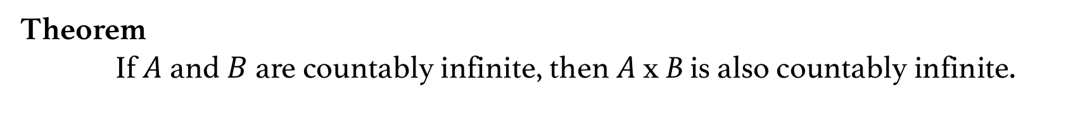
Theorem
If $A$and $B$are countably infinite, then $A$ x B is also countably infinite.
Proof
$A$= { $a_{1}$, $a_{2},a_{3}$, … }
B = { $b_{1}$, $b_{2},b_{3}$, … }
$A x$ $B$= {($a_{i}$, $b_{j}$) | $a_{i}$ ∊ $A$, $b_{j}$ ∊ B }
Is the integer point sets in k-dimensional space countable ?
Is the integer point sets in infinite-dimensional space countable ?

Slide 13
Is the integer point sets in infinite-dimensional space countable ?
We can construct a one-to-one correspondence between the integer point sets in infinite-dimensional space and real numbers.
# real numbers = 𝑪 .
𝑪 > or 𝑪 =

Slide 14
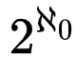
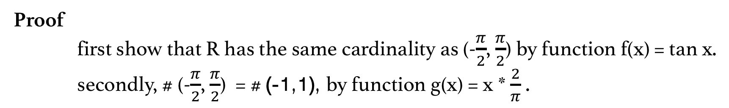
1. Show that R has the same cardinality as the open interval (-1,1).
Proof
first show that R has the same cardinality as (-$\frac{π}{2}$, $\frac{π}{2}$) by function f(x) = tan x.
secondly, # (-$\frac{π}{2}$, $\frac{π}{2}$) = # (-1,1), by function g(x) = x * $\frac{2}{π}$ .
2. Show | R | = .

